Slide 1
Principal Component Analysis

Slide 2
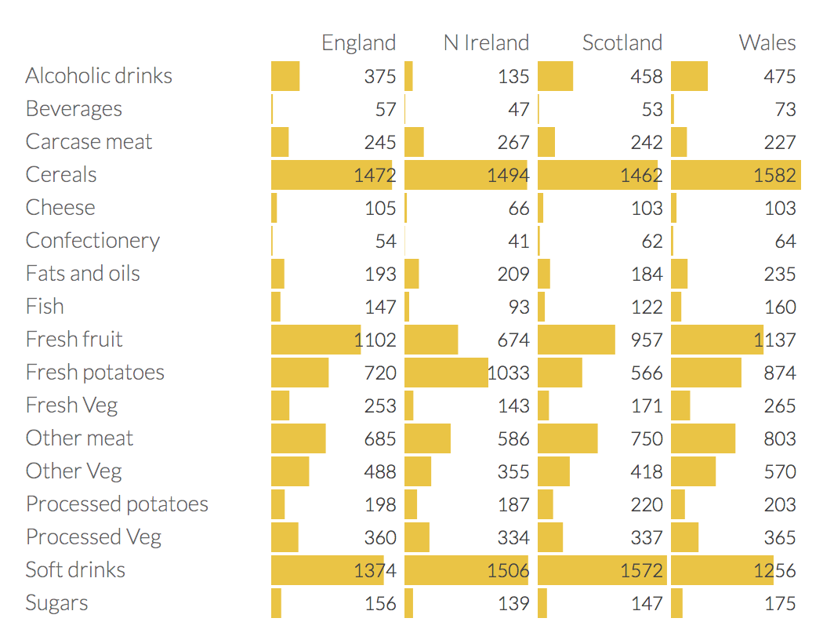
http://setosa.io/ev/principal-component-analysis/
Food consumption in the UK
Notes:
In the table is the average consumption of 17 types of food in grams per person per week for every country in the UK.
The table shows some interesting variations across different food types, but overall differences aren't so notable.
Sample (observation points): 4 countries
Variables (features): food (many of them!)
Let's see if PCA can eliminate dimensions to emphasize how countries differ.
Can we reduce the dimension space from 17 to 1? What about 2?

Slide 3
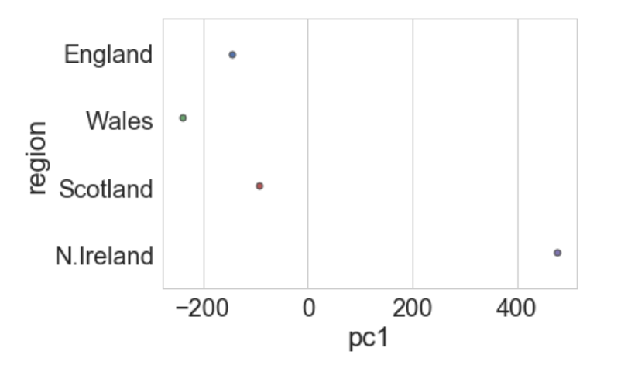
How can we focus in just a few of the variables?
We want to reduce the dimension of the feature space, Let’s try to reduce to one dimension:
pc1: Principal component 1 - linear combination of the other 17 variables
Notes:
Now, see the first and second principal components, we see Northern Ireland a major outlier. Once we go back and look at the data in the table, this makes sense: the Northern Irish eat way more grams of fresh potatoes and way fewer of fresh fruits, cheese, fish and alcoholic drinks. It's a good sign that structure we've visualized reflects a big fact of real-world geography: Northern Ireland is the only of the four countries not on the island of Great Britain.

Slide 4
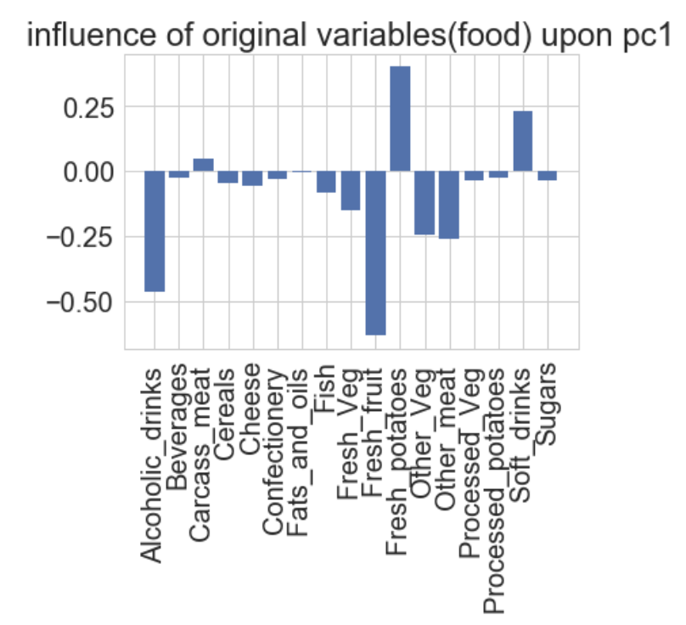
$$pc1=x1 Alcoholic Drinks+x2 Beverages+x3 Carcase meat+ …+x17 Sugars$$

Slide 6
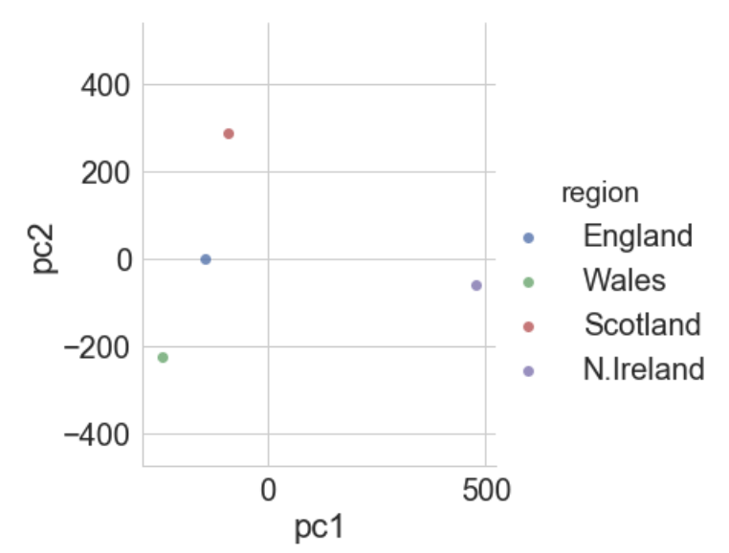
How can we focus in just a few of the variables?
What about reducing to two dimensions?
Notes:
Now, see the first and second principal components, we see Northern Ireland a major outlier. Once we go back and look at the data in the table, this makes sense: the Northern Irish eat way more grams of fresh potatoes and way fewer of fresh fruits, cheese, fish and alcoholic drinks. It's a good sign that structure we've visualized reflects a big fact of real-world geography: Northern Ireland is the only of the four countries not on the island of Great Britain.

Slide 7
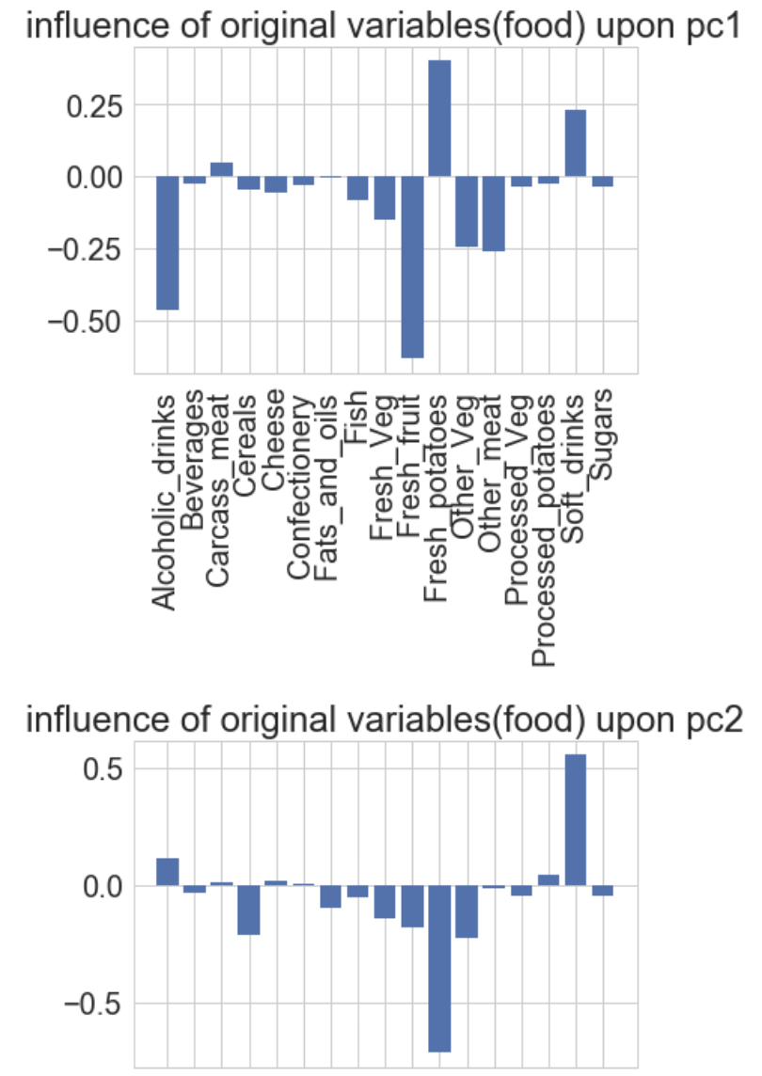
The three variables, Fresh potatoes, Alcoholic drinks and Fresh fruit, there is a noticeable difference between the values for England, Wales and Scotland, which are roughly similar, and Northern Ireland, which is usually significantly higher or lower.

Slide 9
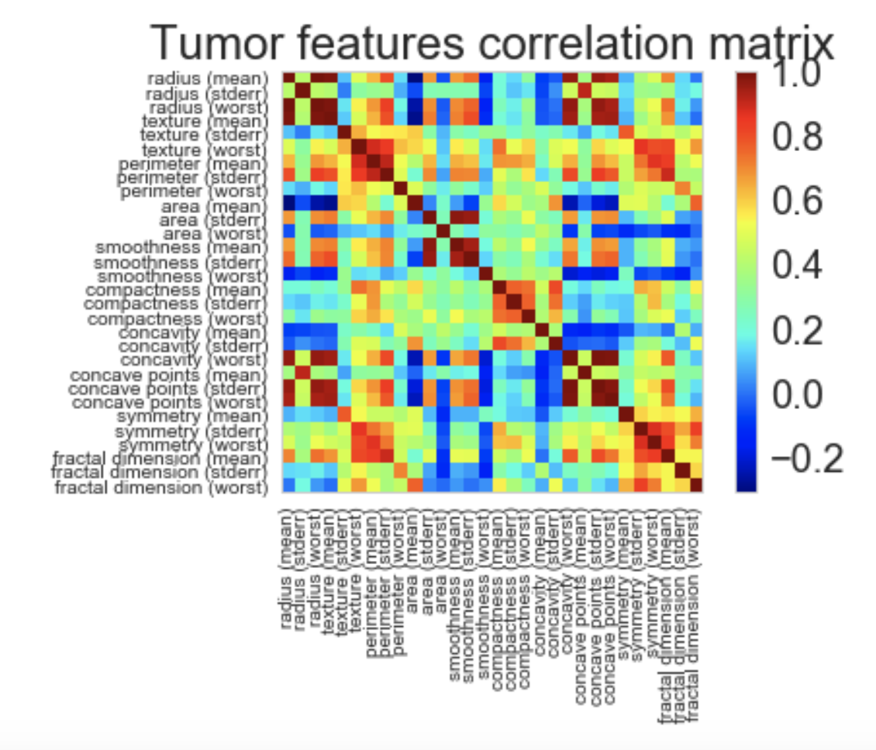
https://www.kaggle.com/shravank/predicting-breast-cancer-using-pca-lda-in-r
Predicting breast cancer
Goal (MP): Use data about tumor cell features to create a model to predict if a breast tumor is malign or benign.
The data includes 30 different cell features.
There are many variables that are highly correlated with each other.
Reduce the feature space:
Approach 1: remove some of the feature variables.
Notes:
If you’ve worked with a lot of variables before, you know this can present problems. Do you understand the relationships between each variable? Do you have so many variables that you are in danger of overfitting your model to your data?

Slide 10
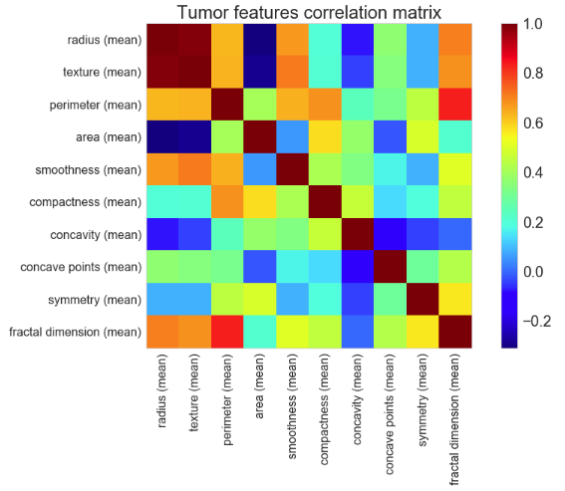
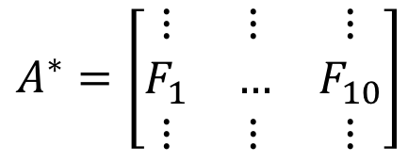
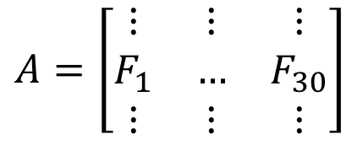
Example: Reduce the feature space by including only the features regarding the mean
$$A=\left[\begin{matrix}⋮ & ⋮ & ⋮ \\ F_{1} & … & F_{30} \\ ⋮ & ⋮ & ⋮\end{matrix}\right]$$
$$A^{∗}=\left[\begin{matrix}⋮ & ⋮ & ⋮ \\ F_{1} & … & F_{10} \\ ⋮ & ⋮ & ⋮\end{matrix}\right]$$
PROS: simple and maintain interpretation of the feature variables
CONS: lose information from the variables that were dropped

Slide 11
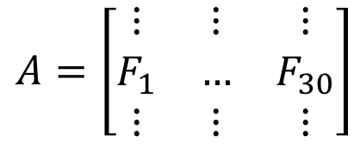
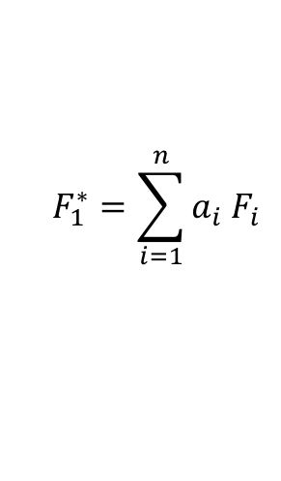
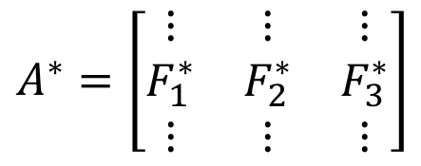
Get a new data set, resulting from a linear combination of the original dataset
$$A=\left[\begin{matrix}⋮ & ⋮ & ⋮ \\ F_{1} & … & F_{30} \\ ⋮ & ⋮ & ⋮\end{matrix}\right]$$
$$A^{∗}=\left[\begin{matrix}⋮ & ⋮ & ⋮ \\ F_{1}^{∗} & F_{2}^{∗} & F_{3}^{∗} \\ ⋮ & ⋮ & ⋮\end{matrix}\right]$$
$$F_{1}^{∗}=\sum_{i=1}^{n}{a_{i}{ F}_{i}}$$
PROS: less variables containing information of all features
CONS: the new features no longer have a “meaningful” interpretation (here a characteristic of a tumor cell)

Slide 12
Principal component analysis
PCA will combine the feature variables in a specific way, creating “new variables”.
We can now drop the “least important” new variables while still retaining the most valuable parts of all of the feature variables!
As an added benefit, each of the “new variables” after PCA are all independent of one another (important requirement for linear models).
Cons: the new variables don’t have the same meaning as the feature variables (loss of interpretability)
Notes:
This is a benefit because the assumptions of a linear model require our independent variables to be independent of one another. If we decide to fit a linear regression model with these “new” variables (see “principal component regression” below), this assumption will necessarily be satisfied.

Slide 13
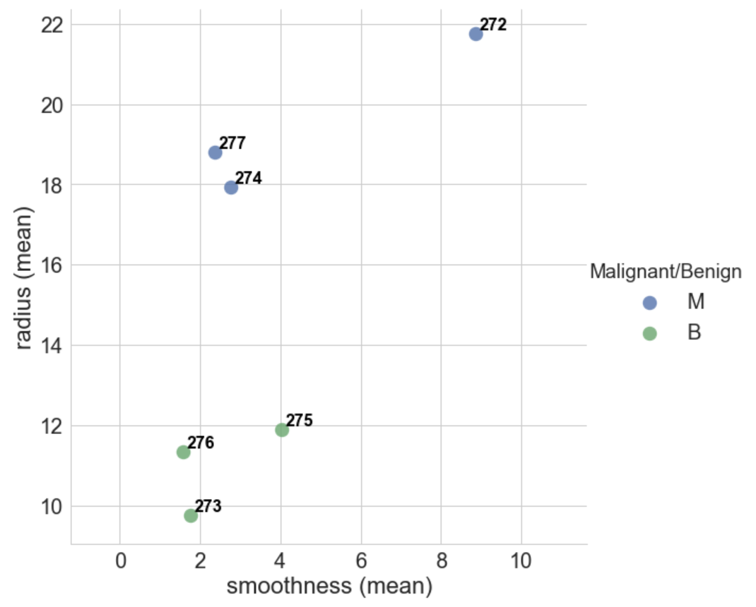
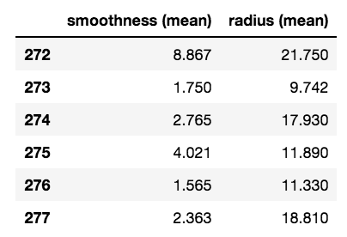
Let’s start with a subset of 6 patients, and take a look at only two of the features: smoothness and radius

Slide 14
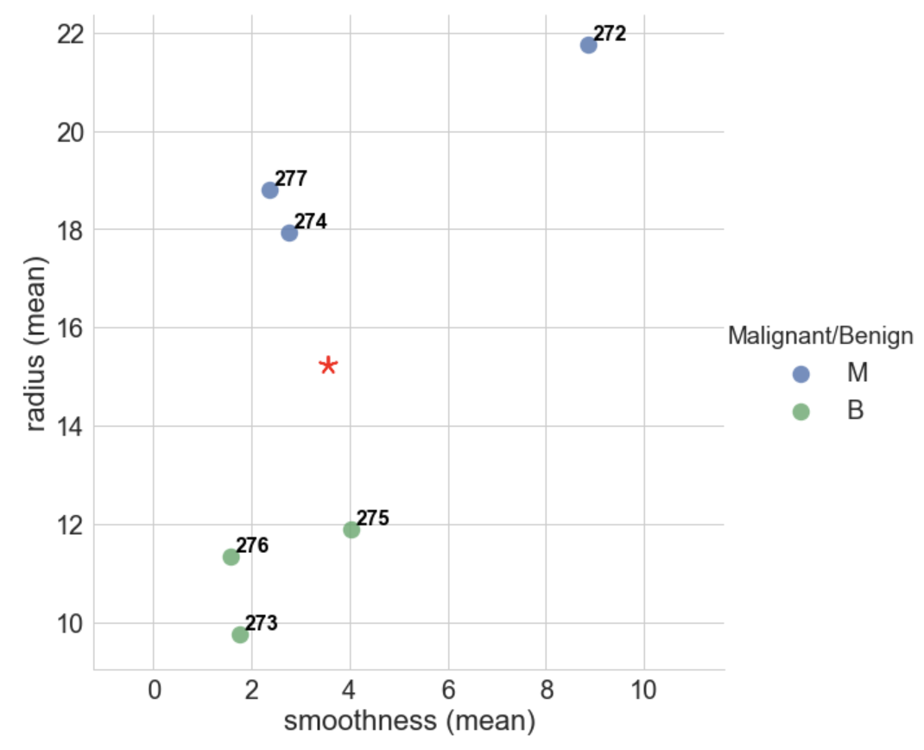
Determine the “center” of the dataset – the mean value of each feature
(3.55, 15.24)

Slide 15
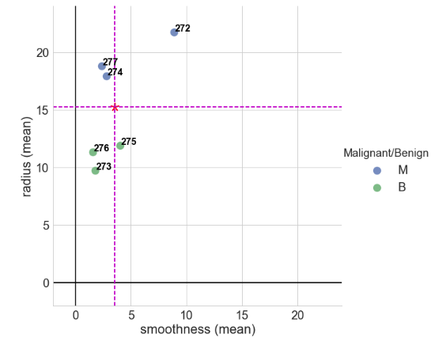
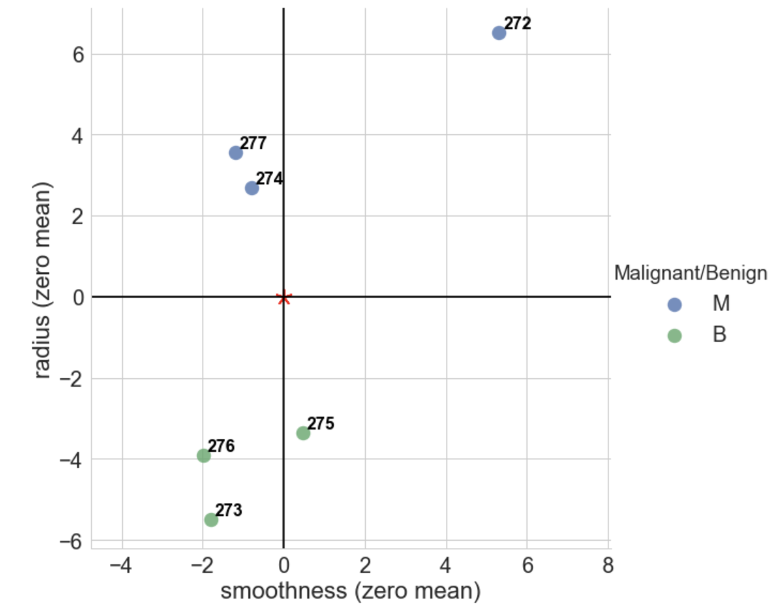
We will shift the dataset such that the “center” of the dataset (mean value) is at the origin (0,0) – the new dataset has zero mean value.

Slide 16
We want to find a straight line that fits the dataset.

Slide 17
Let’s propose the red line below. To quantify how good the fit is, PCA projects the data onto the line. The best fit minimizes the distances from the points to the line (indicated in green below)…

Slide 18
Or maximizes the distances from the projected points to the origin (indicated in orange)

Slide 19
Why are they the same?
Take a look at what happens to the vectors below when we change the fit curve.

Slide 20
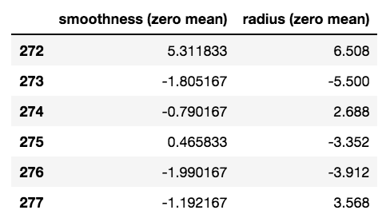
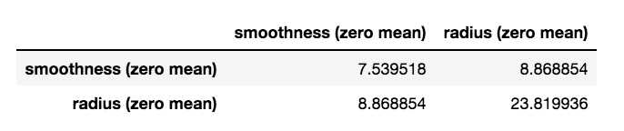
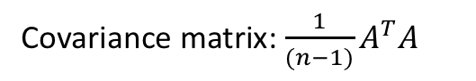
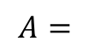
Let’s talk about the variance of the dataset
$$A=$$
Covariance matrix: $\frac{1}{(n−1)}A^{T}A$

Slide 21
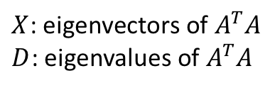
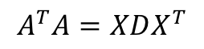
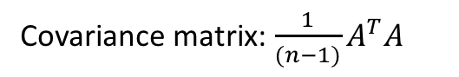
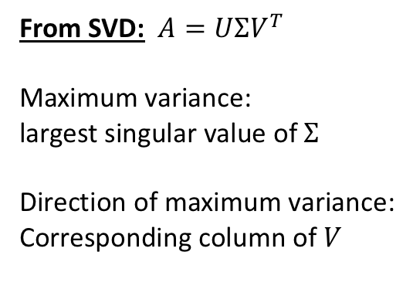
Covariance matrix: $\frac{1}{(n−1)}A^{T}A$
$$A=$$
Diagonalization of covariance matrix:
$$A^{T}A=XDX^{T}$$
$X$: eigenvectors of $A^{T}A$
$D$: eigenvalues of $A^{T}A$
Maximize variance
From SVD: $A=UΣV^{T}$
Maximum variance:
largest singular value of$Σ$
Direction of maximum variance:
Corresponding column of $V$

Slide 22
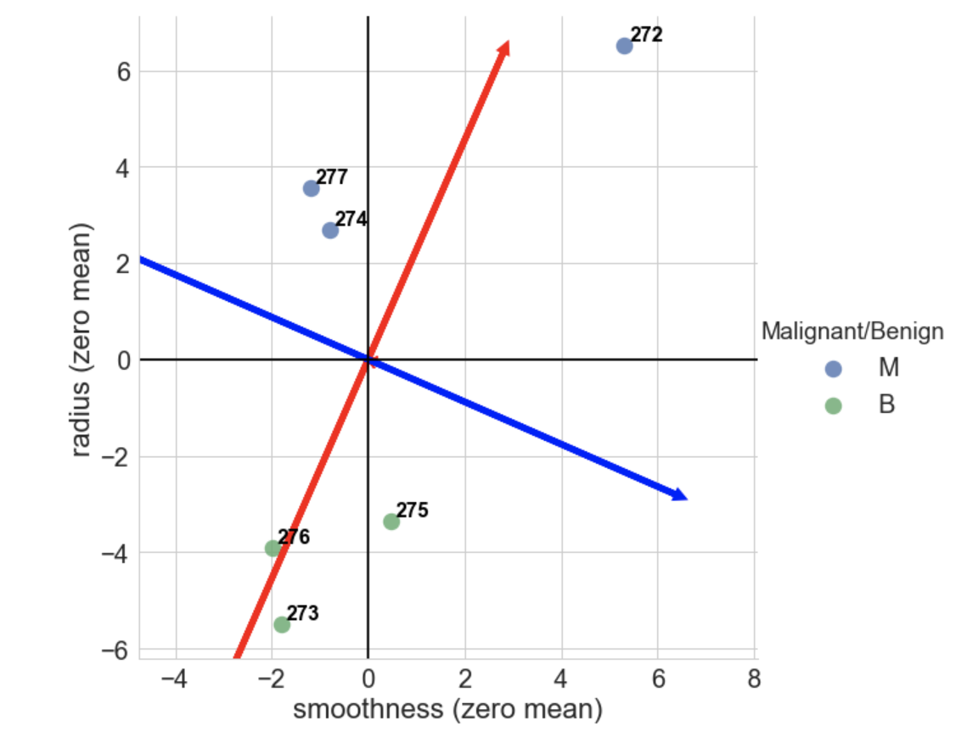
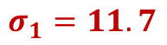
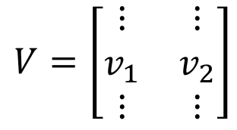
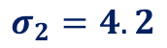
pc1
pc1
pc2
$$V=\left[\begin{matrix}⋮ & ⋮ \\ v_{1} & v_{2} \\ ⋮ & ⋮\end{matrix}\right]$$
pc2
$$σ_{1}=11.7$$
$$σ_{2}=4.2$$

Slide 23
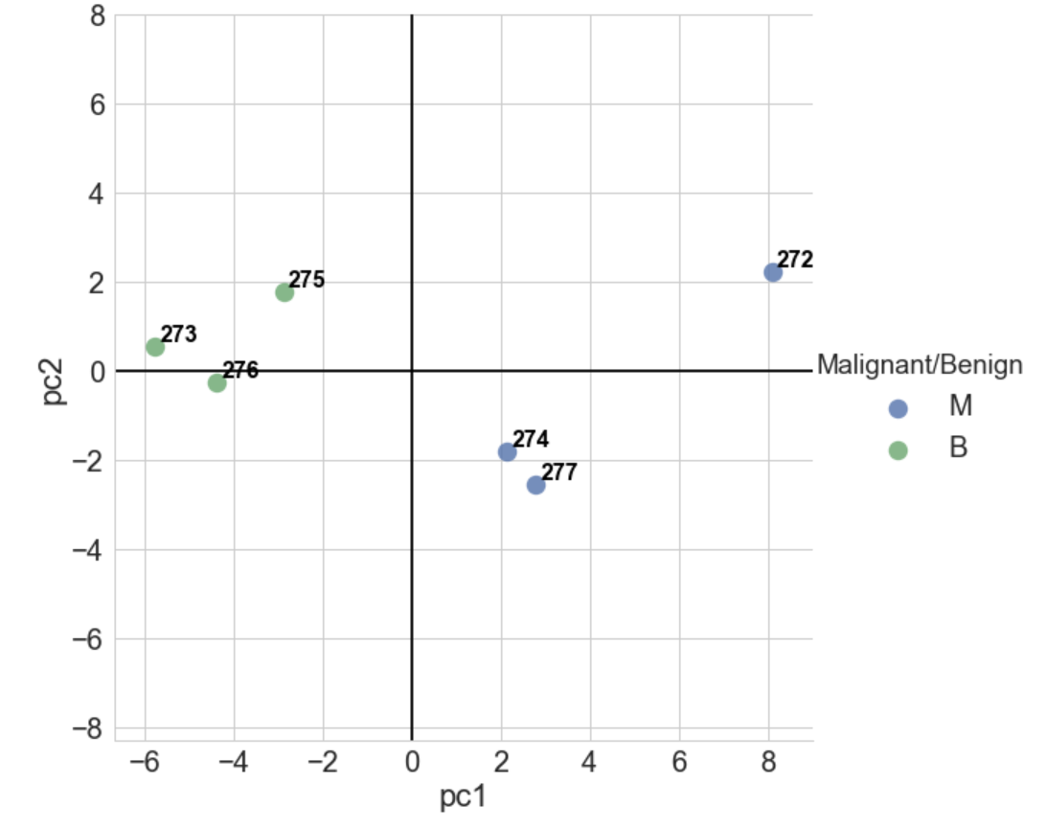
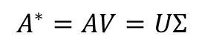
Transformed dataset:
$$A^{∗}=AV=UΣ$$

Slide 24
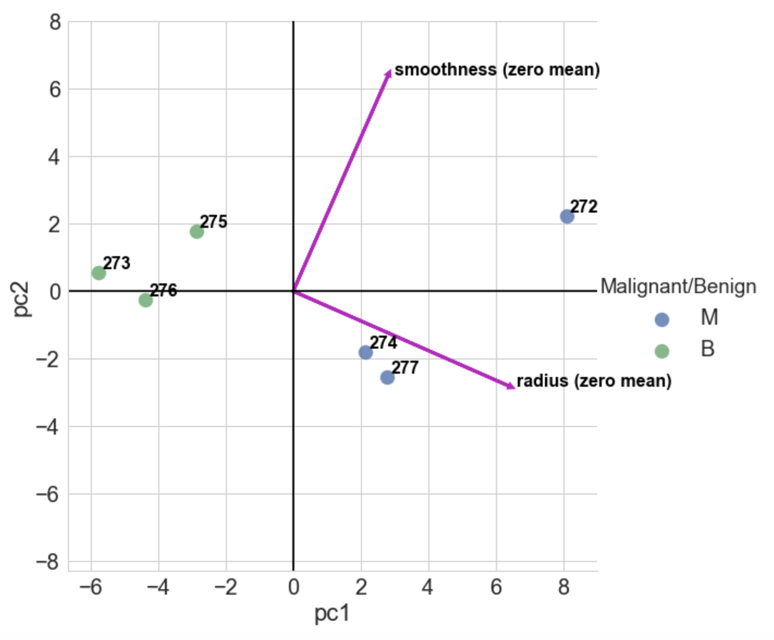

Slide 25
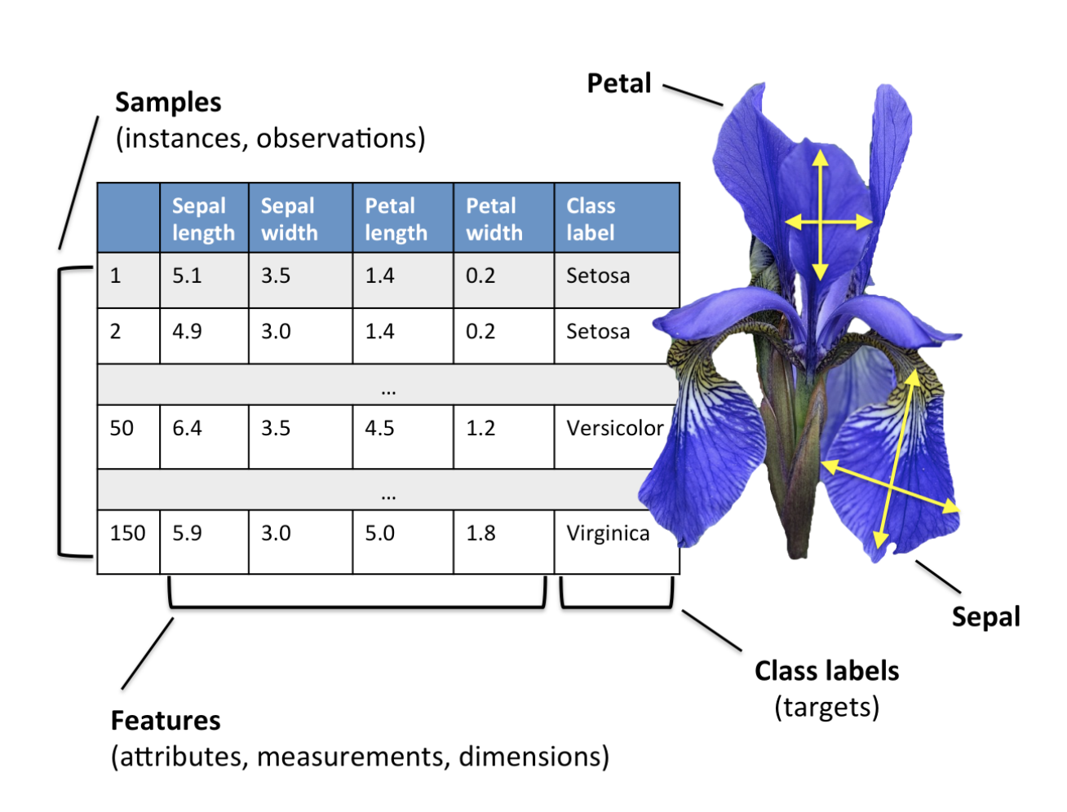
Let’s add more features! Flower classification
http://sebastianraschka.com/Articles/2015_pca_in_3_steps.html
Notes:
What distinguishes the species? Petal and sepal length? Or width? Which “pairs” will show better correlation?
We can plot one parameter versus another one and see what they tell us (the “pair” plot).
Since we are plotting the “true” classification of the flower using colors, we can better distinguish the categories.
But it would be hard to do such categorization if we didn’t have the colors. Moreover, we only have 150 sample points, and 4 features.
But what if we had a larger dataset? Or more features to distinguish each specie?
Discuss “pair” plot

Slide 26
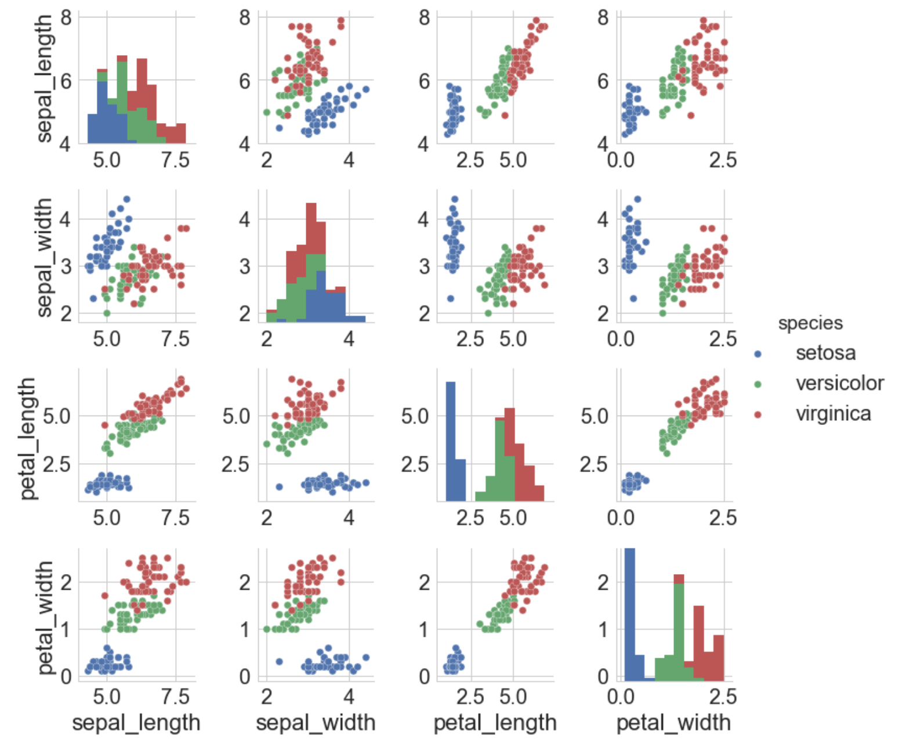
Notes:
What distinguishes the species? Petal and sepal length? Or width? Which “pairs” will show better correlation?
We can plot one parameter versus another one and see what they tell us (the “pair” plot).
Since we are plotting the “true” classification of the flower using colors, we can better distinguish the categories.
But it would be hard to do such categorization if we didn’t have the colors. Moreover, we only have 150 sample points, and 4 features.
But what if we had a larger dataset? Or more features to distinguish each specie?
Discuss “pair” plot

Slide 27
Principal component analysis
How can we reduce the dimension of a dataset without missing important information?
Detect correlation between variables, if a strong correlation exists, then reducing the dimension of the dataset makes sense.
Overall idea: Find the directions of maximum variance in high-dimensional dataset (n dimension) and project it onto a subspace with smaller dimension (k dimension, with k < n), while retaining most of the information.
What is the adequate value for k?
Demo “Features and the SVD”

Slide 28
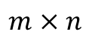
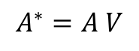
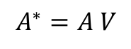
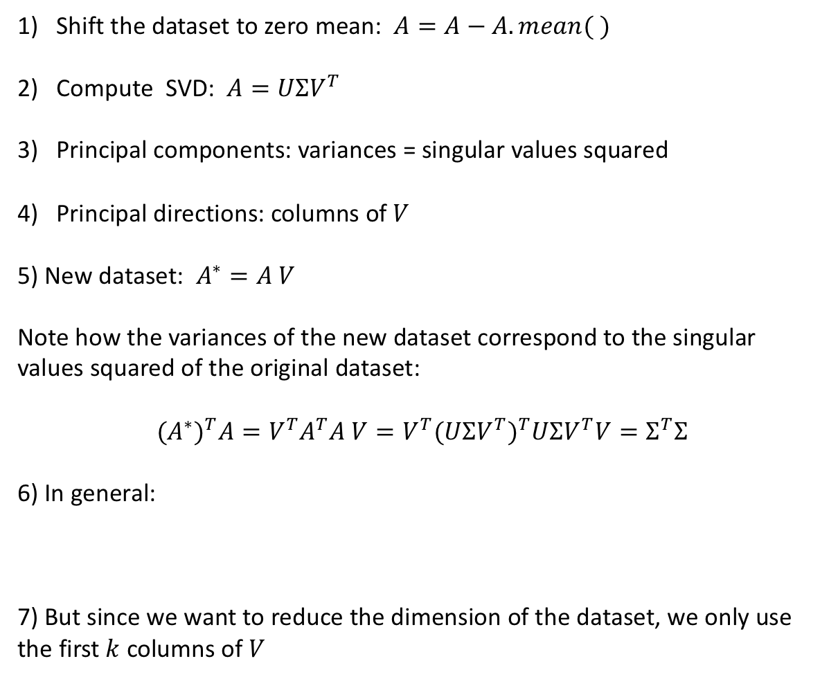
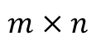
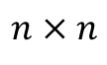
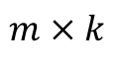
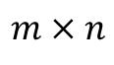
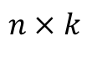
Shift the dataset to zero mean: $A=A−A.mean( )$
Compute SVD: $A=UΣV^{T}$
Principal components: variances = singular values squared
Principal directions: columns of $V$
5) New dataset: $A^{∗}=A V$
Note how the variances of the new dataset correspond to the singular values squared of the original dataset:
$${(A^{∗})}^{T}A=V^{T}A^{T}A V={V^{T}(UΣV^{T})}^{T}UΣV^{T}V=Σ^{T}Σ$$
6) In general:
7) But since we want to reduce the dimension of the dataset, we only use the first $k$ columns of $V$
$$A^{∗}=A V$$
$$n × n$$
$$m × n$$
$$m × n$$
$$A^{∗}=A V$$
$$m × k$$
$$m × n$$
$$n × k$$

Slide 29
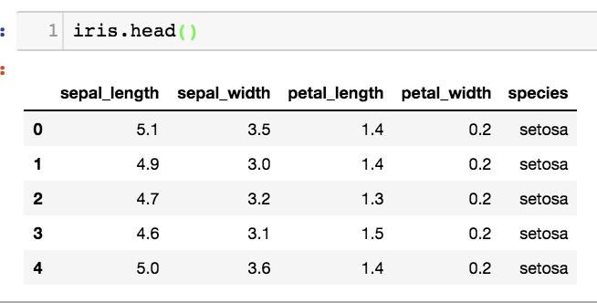
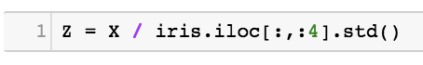
Iris dataset
Shift the dataset to zero mean:
Optional (modeling choice!): decide whether or not to standardize. If you want to standardize, divide each observation in a column by that column’s standard deviation.
In this new dataset Z each feature has mean zero and standard deviation 1.
This decision depends on the problem you are solving. If some variables have a large variance and some small, since PCA maximizes the variance, it will weight more the features with large variance. If you want your PCA to be independent of the variance, standardizing the features will do that.

Slide 30
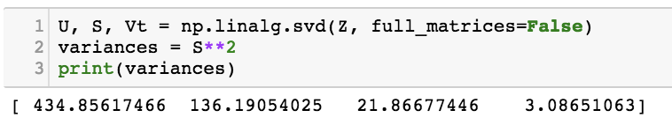
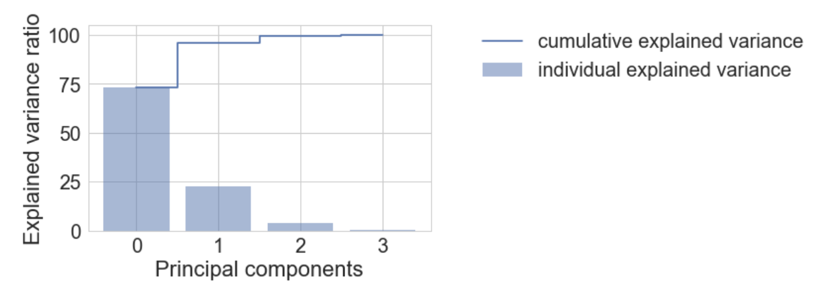
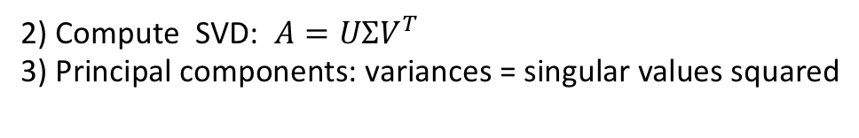
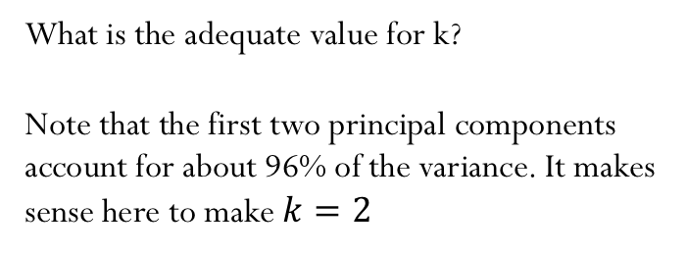
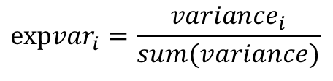
Explained variance
2) Compute SVD: $A=UΣV^{T}$
3) Principal components: variances = singular values squared
Explained variance:
$${expvar}_{i}=\frac{{variance}_{i}}{sum(variance)}$$
What is the adequate value for k?
Note that the first two principal components account for about 96% of the variance. It makes sense here to make $k=2$

Slide 31


Slide 32



5) New REDUCED dataset:
$$Z^{∗}=\left[\begin{matrix}⋮ & ⋮ \\ p0 & p1 \\ ⋮ & ⋮\end{matrix}\right]$$

Slide 33




Weight (importance) of each feature in the principal components

Slide 34



Let’s go back to a dataset with many features!

Slide 35


Slide 36


